Slide 1
“Come, Holy Spirit, fill the hearts of Your faithful,
kindle in them the fire of Your love;
send forth Your spirit and they shall be created
and You will renew the face of the Earth”

Slide 2
The Lay of the Land:

Slide 3
The Lay of the Land:
Session 1: The Holy Spirit in the Life of the Trinity
God as Relationship
The Holy Spirit Proceeding from the Father and the Son

Slide 4
The Lay of the Land:
Session 1: The Holy Spirit in the Life of the Trinity
God as Relationship
The Holy Spirit Proceeding from the Father and the Son
Session 2: The Holy Spirit in the Life of the Church
The Old Testament: The Presence of the Spirit in Israel and in Revelation
The New Testament: The Abiding Presence of the Spirit
The Magisterium: The Ongoing Work of the Spirit

Slide 5
The Lay of the Land:
Session 1: The Holy Spirit in the Life of the Trinity
God as Relationship
The Holy Spirit Proceeding from the Father and the Son
Session 2: The Holy Spirit in the Life of the Church
The Old Testament: The Presence of the Spirit in Israel and in Revelation
The New Testament: The Abiding Presence of the Spirit
The Magisterium: The Ongoing Work of the Spirit
Session 3: The Holy Spirit in the Life of the Baptized
The Seven Gifts of the Spirit
One Spirit, One People: The Communion of the Holy Spirit
The Dynamic Spirit: Evangelization as the Work of the Holy Spirit

Slide 6
The Holy Spirit in the People of God

Slide 7
The Holy Spirit in the People of God
So the upshot is God exists as relationship

Slide 8
The Holy Spirit in the People of God
So the upshot is God exists as relationship
and not a closed relationship between the Father and Son

Slide 9
The Holy Spirit in the People of God
So the upshot is God exists as relationship
and not a closed relationship between the Father and Son
but an ever-open relationship
among three Persons

Slide 10
The Holy Spirit in the People of God
Because it is an open relationship and dynamic,
that bond of love Who is the Holy Spirit is constantly at work

Slide 11
The Holy Spirit in the People of God
The very nature of the relationship is generative ~ it produces simply by being

Slide 12
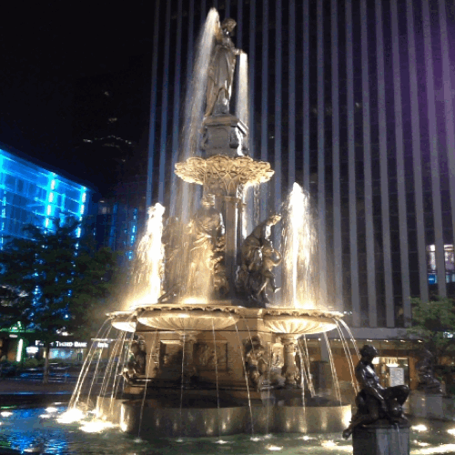
The Holy Spirit in the People of God

Slide 13
The Holy Spirit in the People of God
Like a water fountain

Slide 14
The Holy Spirit in the People of God
Like a water fountain
that constantly fills one tray

Slide 15
The Holy Spirit in the People of God
Like a water fountain
that constantly fills one tray and spills out over into another

Slide 16
The Holy Spirit in the People of God
Like a water fountain
that constantly fills one tray and spills out over into another,
and fills that one

Slide 17
The Holy Spirit in the People of God
Like a water fountain
that constantly fills one tray and spills out over into another,
and fills that one, and spills over
into another…

Slide 18
The Holy Spirit in the People of God
So creation is a function ~ or an expression ~ of God’s love

Slide 19
The Holy Spirit in the People of God
And when He reveals Himself to us as Trinity

Slide 20
The Holy Spirit in the People of God
And when He reveals Himself to us as Trinity
He is sharing with us Who He (They?) are

Slide 21
The Holy Spirit in the People of God
This unfolds in the lives of His Chosen People

Slide 22
The Holy Spirit in the People of God
This unfolds in the lives of His Chosen People
and the way they reflect on how God has revealed Himself to them

Slide 23
The Holy Spirit in the People of God
This unfolds in the lives of His Chosen People
and the way they reflect on how God has revealed Himself to them ~ the Bible

Slide 24
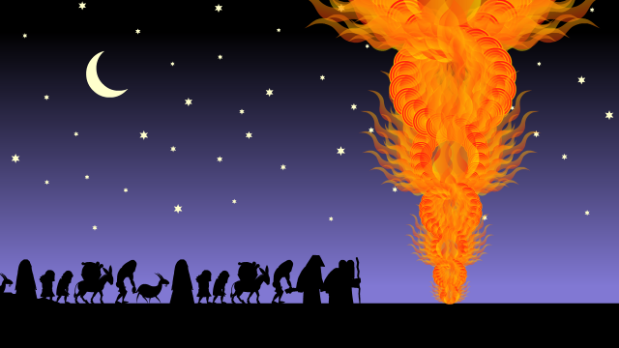
The Holy Spirit in the People of God
“By day the Lord went before them in a pillar of cloud to guide them on their way, and by night in a pillar of fire to give them light” (Ex 13:21)

Slide 25
The Holy Spirit in the People of God
Just as in the New Testament, tongues of fire represent the Holy Spirit (Acts 2:3), Who leads them into all truth (Jn 16:13)

Slide 26
The Holy Spirit in the People of God
Just as in the New Testament, tongues of fire represent the Holy Spirit (Acts 2:3), Who leads them into all truth (Jn 16:13)
The pillar of fire is the manifestation of the Holy Spirit, Who leads God’s Chosen Ones into the Promise Land

Slide 27
The Holy Spirit in the People of God
But the Holy Spirit’s presence in Israel is not a stable presence ~
“The Holy Spirit had not yet been given, because Jesus was not yet glorified” (Jn 7:39)

Slide 28
The Holy Spirit in the People of God
The Spirit was given to the Jewish people, but just as easily could be withdrawn ~
as when God removed His favor from King Saul (1 Sam 15:35)

Slide 29
The Holy Spirit in the People of God
Prophets like Samuel, Elijah, Elisha, and others were anointed with the Holy Spirit to speak the Word of God to His people

Slide 30
The Holy Spirit in the People of God
Prophets like Samuel, Elijah, Elisha, and others were anointed with the Holy Spirit to speak the Word of God to His people,
as were the authors of the Jewish Scriptures

Slide 31
The Holy Spirit in the People of God
Prophets like Samuel, Elijah, Elisha, and others were anointed with the Holy Spirit to speak the Word of God to His people,
as were the authors of the Jewish Scriptures,
in order to begin to shape a people especially for God

Slide 32
The Holy Spirit in the People of God
. . . And of course the revealing of God’s Mind to the people is a form of Communion

Slide 33
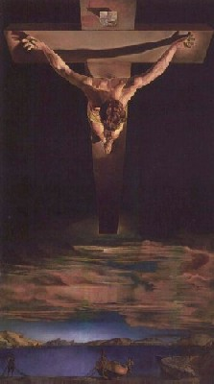
The Holy Spirit in the People of God
But the abiding Communion with God that is the presence of the Holy Spirit is a gift bestowed by the Son, as a consequence of His atoning Passion

Slide 34
The Holy Spirit in the People of God

Slide 35
The Holy Spirit in the People of God
The New Testament

Slide 36
The Holy Spirit in the People of God
When the Holy Spirit descended on the apostles at Pentecost,
the deeper truth of God’s plan was revealed to them

Slide 37
The Holy Spirit in the People of God
The traditional understanding of the prophecies of the Messiah looked for a royal dynasty who would restore the earthly kingdom of David

Slide 38
The Holy Spirit in the People of God
But with the guidance of the Holy Spirit, the apostles now began to understand these prophecies as pointing to a spiritual kingdom

Slide 39
The Holy Spirit in the People of God
The conventional human meaning was deepened
and the veil was lifted to reveal God’s eternal plan

Slide 40
The Holy Spirit in the People of God
“These things God has revealed to us through the Spirit; for the Spirit searches everything, even the deep things of God” (1 Cor 2:10)

Slide 41
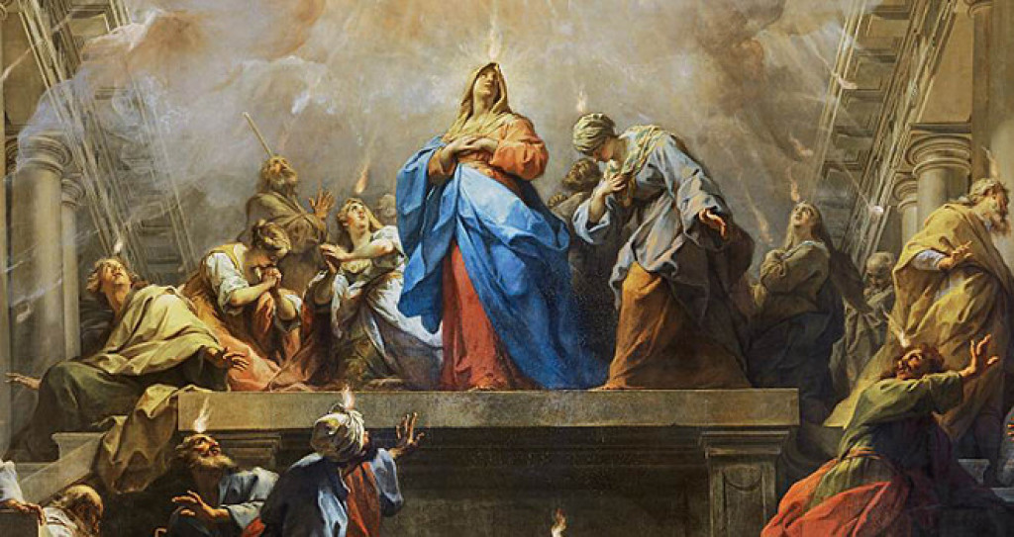
The Holy Spirit in the People of God
With the completion of God’s plan for our salvation, the Holy Spirit is given to us as His abiding presence

Slide 42

The Holy Spirit in the People of God
  And with that, a better knowledge of the fullness of God’s plan

Slide 43
The Holy Spirit in the People of God
“You also, who have heard the word of truth, the gospel of your salvation, and have believed in Him, were sealed with the promised Holy Spirit” (Eph 1:13)

Slide 44

The Holy Spirit in the People of God
To be sealed is to be fastened securely ~ permanently

Slide 45
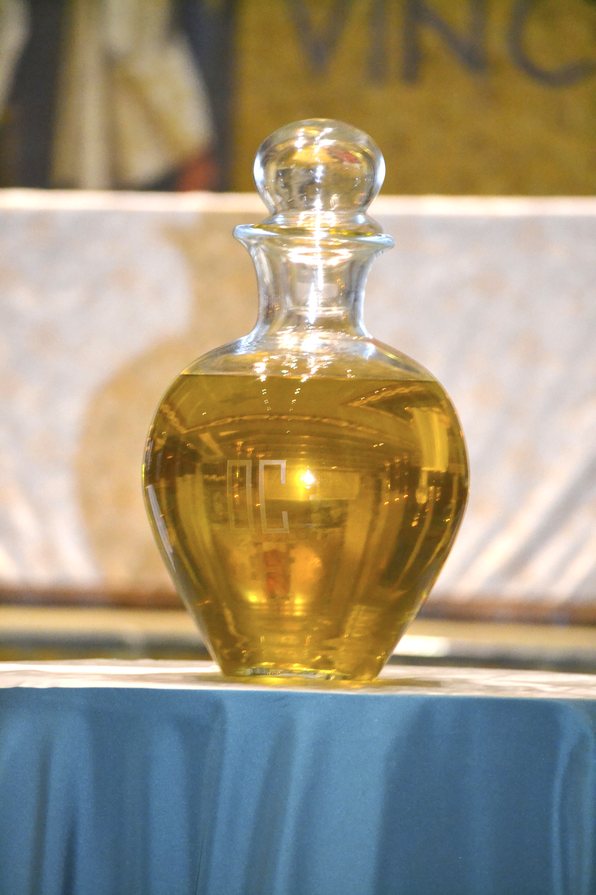
The Holy Spirit in the People of God
And we receive that seal in baptism

Slide 46
The Holy Spirit in the People of God
And we receive that seal in baptism
in Confirmation

Slide 47
The Holy Spirit in the People of God
And we receive that seal in baptism
in Confirmation
and in Holy Orders

Slide 48
The Holy Spirit in the People of God
But the Communion of the Holy Spirit
not only brings Him into us

Slide 49
The Holy Spirit in the People of God
But the Communion of the Holy Spirit
not only brings Him into us
. . . it also flows out from us

Slide 50
The Holy Spirit in the People of God
But the Communion of the Holy Spirit
not only brings Him into us
. . . it also flows out from us

Slide 51
The Holy Spirit in the People of God
More on this next week!

Slide 52
The Holy Spirit in the People of God
How does it change your understanding of the Trinity to think that the work of the Trinity in our lives shows us Who He is?
What images can you think of that help visualize the Holy Spirit as the One Who draws us into Communion?
Does the abiding presence of the Holy Spirit give any new meaning to the Creed’s line about Him as “the Lord, the Giver of Life”?

Slide 53
“Come, Holy Spirit, fill the hearts of Your faithful,
kindle in them the fire of Your love;
send forth Your spirit and they shall be created
and You will renew the face of the Earth”

